Slide 1
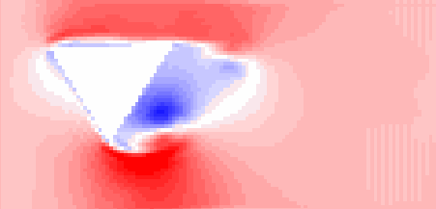
2D Fluid Flow
Using Attention

Slide 2
Outline
Objectives
Simulation Set Up
Infrastructure
Baselines
Architecture
Results
Next Steps

Slide 3
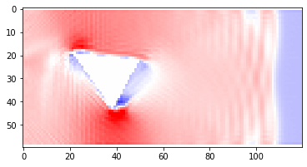
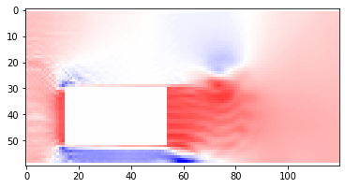
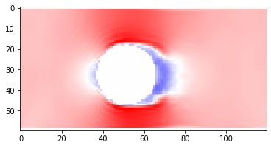
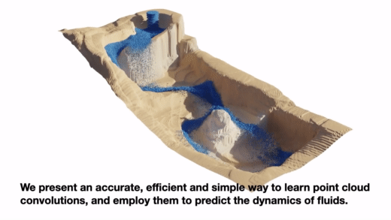
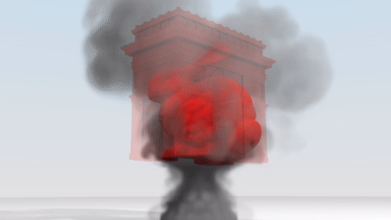
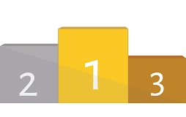
Objectives
ML-Based Physics Simulations
Emerging Field
Lack of Benchmark Datasets
Lack of Standard Performance
Deliverables:
2D Dataset
300K Samples
Helper Functions for DOE’s
Develop Benchmark Metric
Set of Models for Comparison
Notes:
ML Physical simulations have garnered interest over the last 3 years
There is no commonly used dataset
No Agreement on Performance Metrics
So what I set out to deliver:
2D Dataset
300K samples developed over 1000 simulations
Libraries for parsing and permuting the simulation data in various ways
Identify Proper Benchmark Performance Metrics
Set of Baseline Models

Slide 4
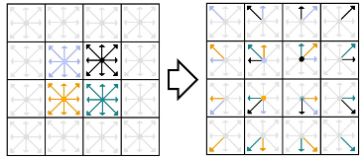
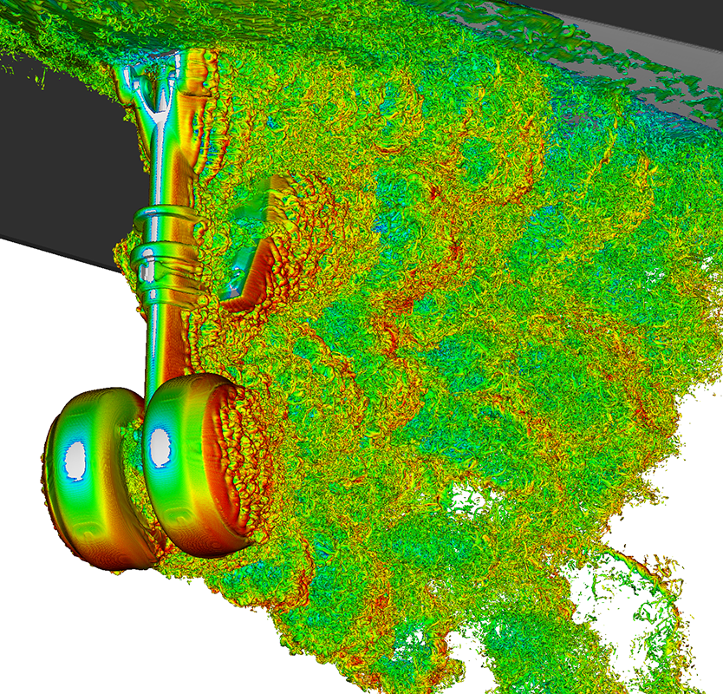
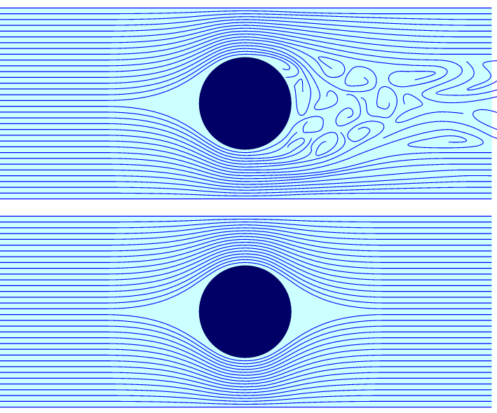
Simulation Setup
Generates Scenes:
Shape Primitives
Random Reynolds Number
30 Hz Sampling Rate
Scenes last for 10s
Lattice Boltzmann Solver:
Fast
Python Library
Notes:
Another Flavor of fluid solver
It is really fast, and parallelizable on a GPU

Slide 5
Infrastructure
Simulation Generating Scripts
Library Functions for Data Parsing
Data Scalar Pipelines
Pre-Scaled DataSets
Notes:
Data Parsing:
Simulation to X-Y Pairs
Single-In - Single-Out
Multi-In - Multi-Out
Data Scalers:
Batch processing
On the fly
Simulation Datasets
100 Simulations ~ 30K Data Points
SiSo
MiSo
MiMo

Slide 6
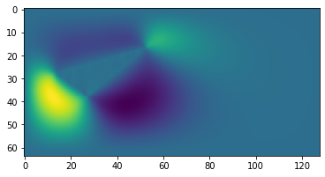
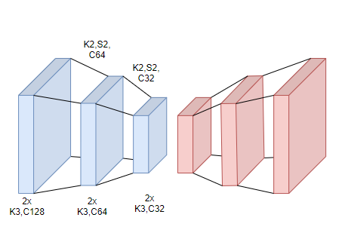
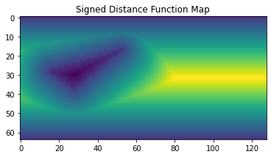
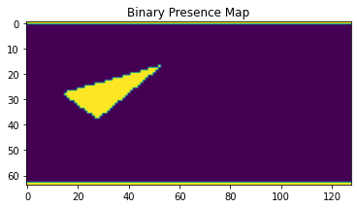
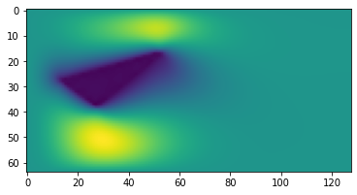
Baseline Models
Conv FF Model
Vy
Vy
Vx
Vx
SDF
SDF
Binary
Re #
Notes:
This will get more descriptive, this is a place holder

Slide 7
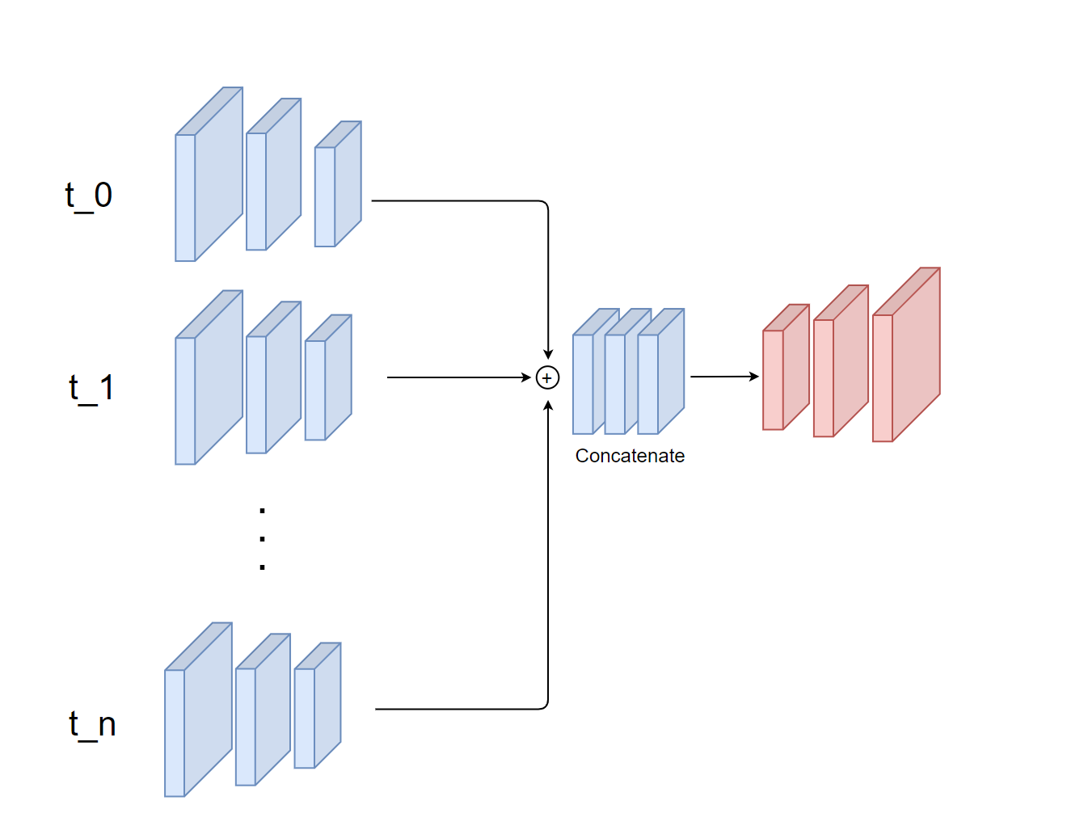
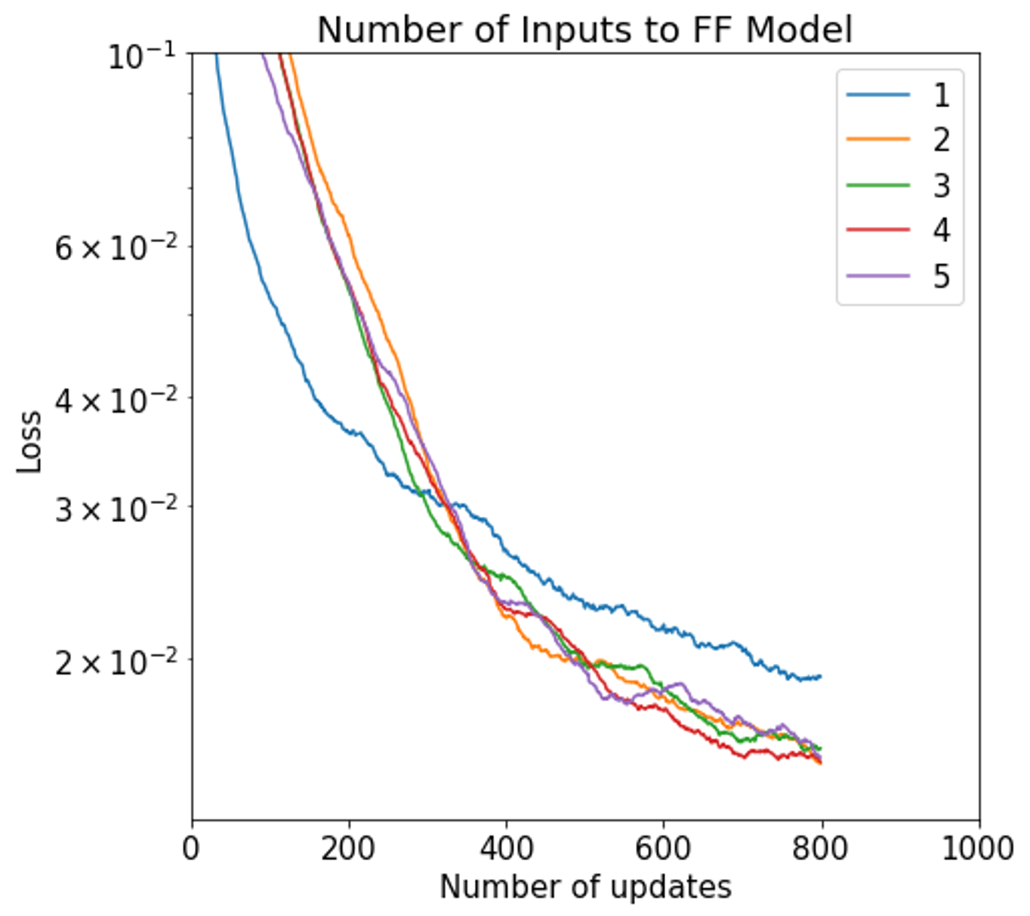
Multi-Input Models
Conv FF Model
Notes:
This will get more descriptive, this is a place holder

Slide 8
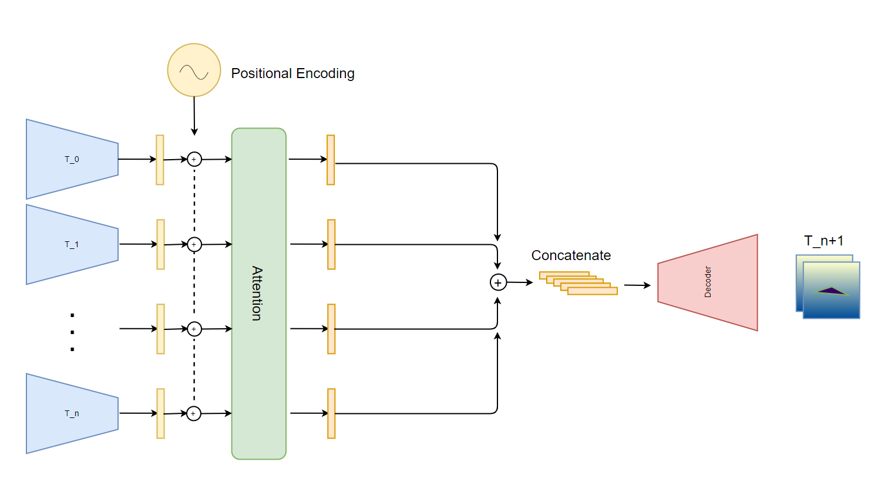
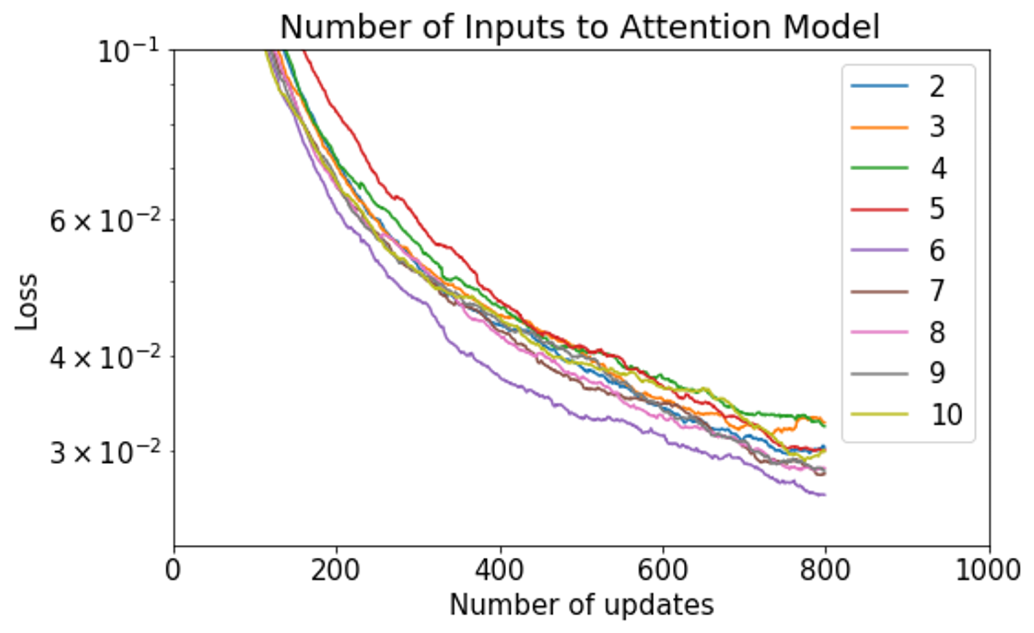
Baseline Models Pt. 2:
Multi-Input w/ Attention
Notes:
Multi-Step Model:
There is something to be gained from adding an additional input,
However

Slide 9
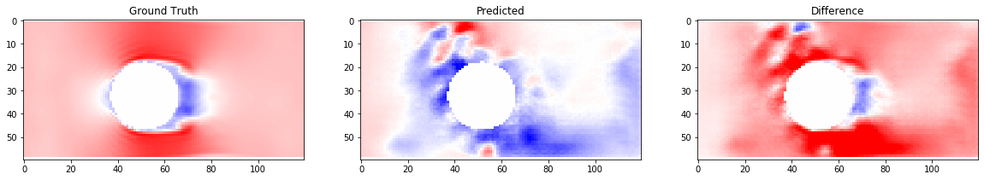
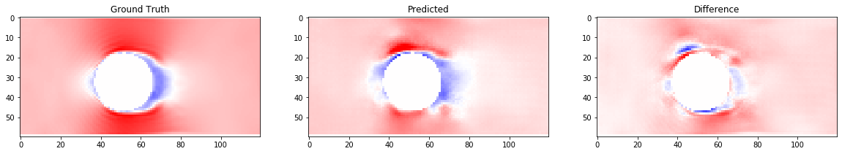
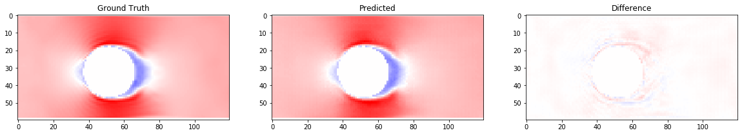
Model Divergence
Ground Truth
Prediction
T=10
T=1
T=50
Notes:
Add Animation - Can See that the Model Diverges as we move forward in time
Necessitates Multi-Step Model

Slide 10
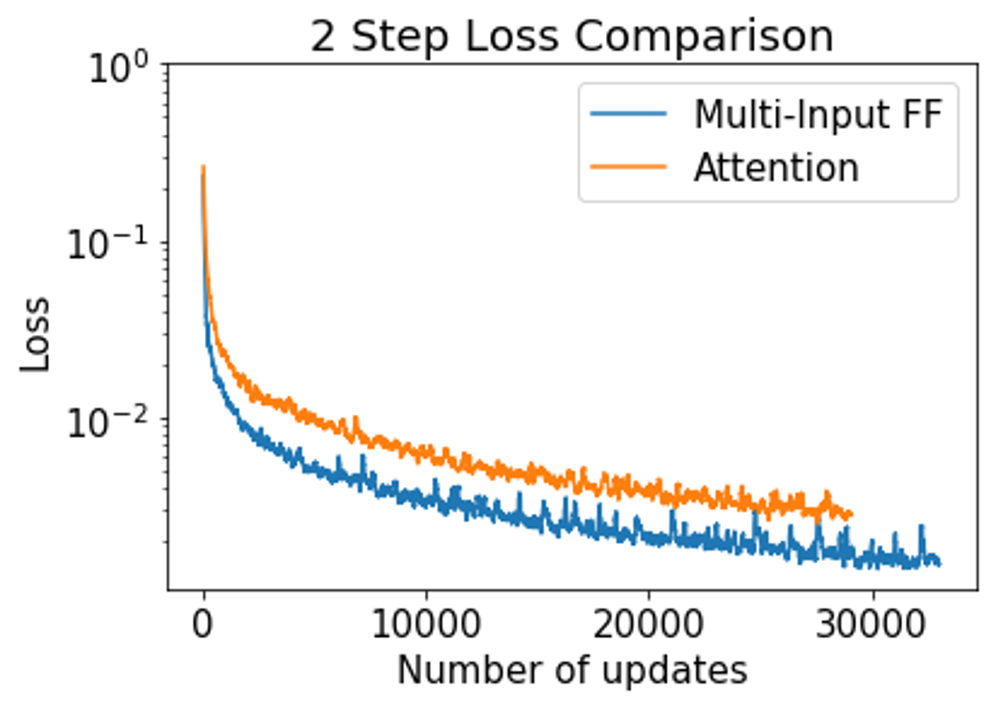
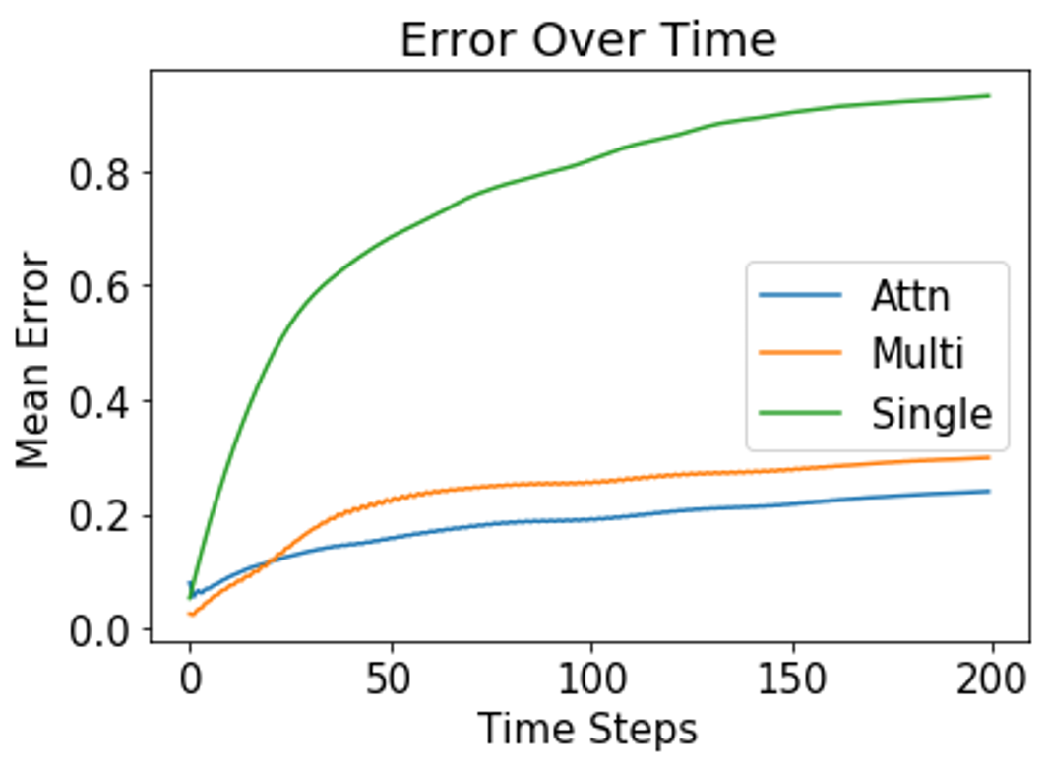
Performance Comparison
Notes:
Add Animations

Slide 11
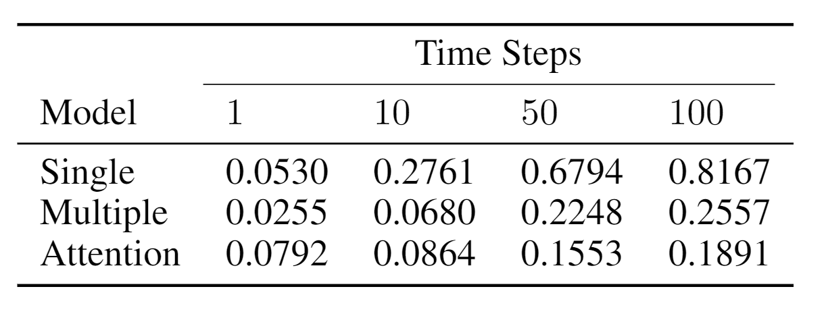
Performance Comparison pt. 2
(Model Comparison: Average Error Vs. Time Step)
Notes:
Table Detailing Loss Vs. Number of Steps will be here

Slide 12
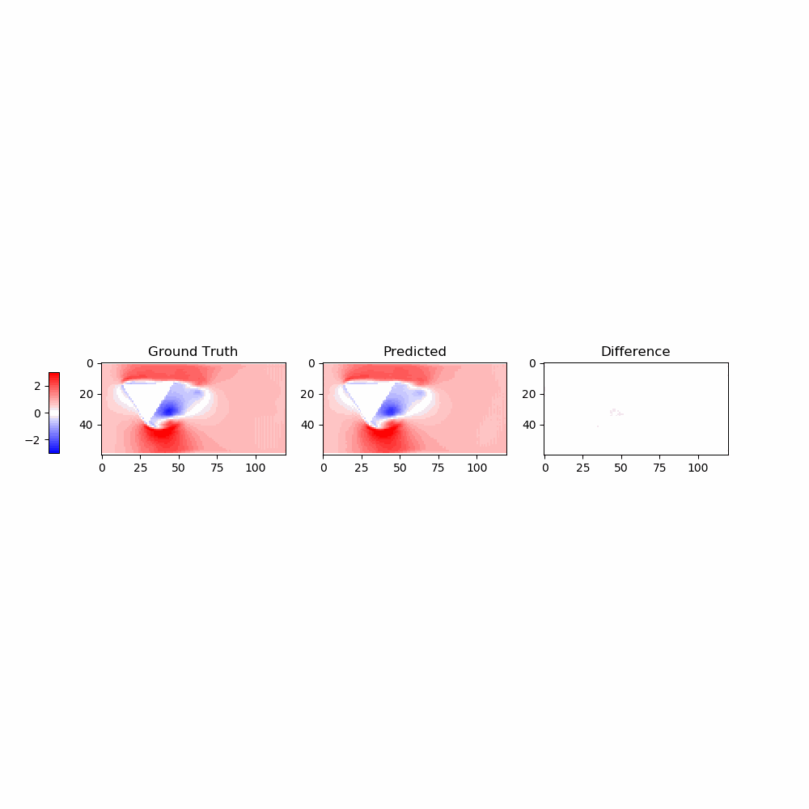


Visualization Comparison
Ground Truth
Single Input
Multiple Input
Attention Model

Slide 13
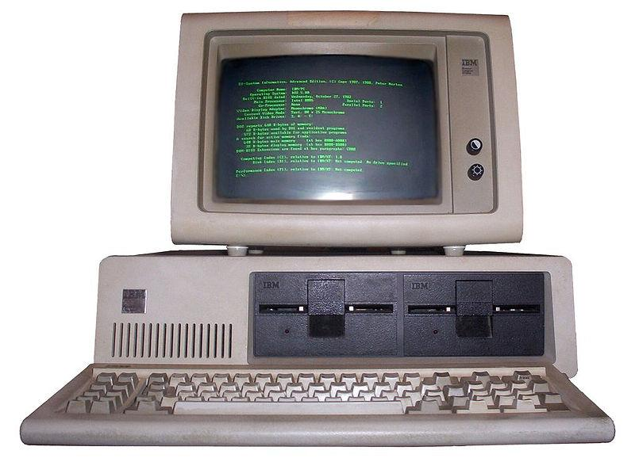
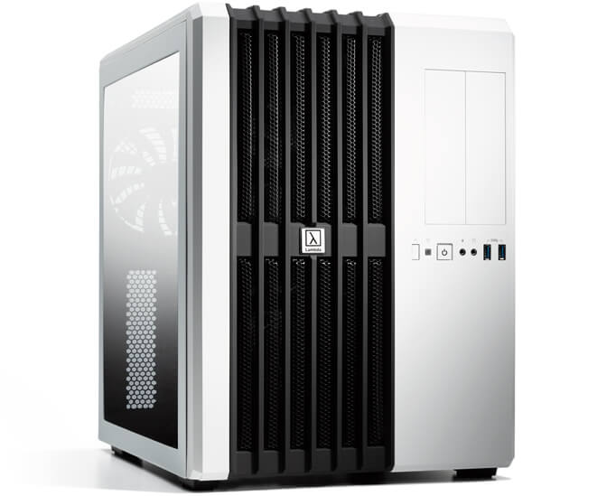
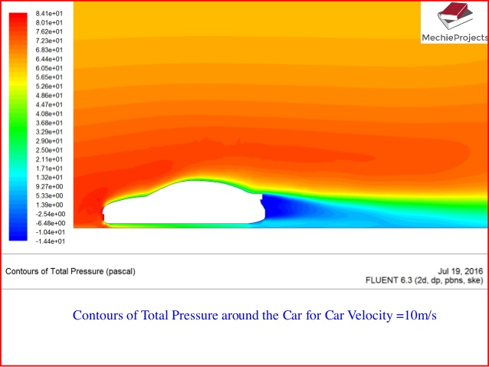
Next Steps
More Compute
Architecture Search
Divergence vs Time
Complex Geometry

Slide 14
Thank You!
Any Questions?

